Slide 1
STOCK PRICE PREDICTION
--- BY
2110030105 SHIREEN
2110039472 G.SRIRAG
2110030352 T.NIKITHA REDDY
2110030449 A.VARSHINI
2110030320 S.NIKHITHA

Slide 2
INTRODUCTION
Stock Price Prediction using machine learning helps you discover the future value of company stock and other financial assets traded on an exchange. The entire idea of predicting stock prices is to gain significant profits. Predicting how the stock market will perform is a hard task to do. There are other factors involved in the prediction, such as physical and psychological factors, rational and irrational behavior, and so on. All these factors combine to make share prices dynamic and volatile. This makes it very difficult to predict stock prices with high accuracy.

Slide 3
PROBLEM STATEMENT
Stock market prediction and analysis are some of the most difficult jobs to complete. There are numerous causes for this, including market volatility and a variety of other dependent and independent variables that influence the value of a certain stock in the market. These variables make it extremely difficult for any stock market expert to anticipate the rise and fall of the market with great precision.

Slide 4
LITERATURE REVIEW
Research in finance has explored how stock markets are affected by their multi- source and heterogeneous data on some scales. Multi-source heterogeneous data in the stock market means that the data of the stock market includes data from different sources such as the stock market, the foreign exchange market and even the weather system, as well as the structure of stock prices, trading volumes, and stock news, announcements and social networks. and other unstructured data. In particular, the efficient market hypothesis believes that information from various sources in the stock market will have an impact on the stock market, while behavioral finance believes that financial markets are explained, studied and predicted from the individual behaviors of traders and the motivations that produce such behaviors.
REFERENCE-
https://www.ijeast.com/papers/258-262,Tesma508,IJEAST.pdf

Slide 5
DATASET COLLECTION
Yahoo Finance
https://finance.yahoo.com/?guccounter=1&guce_referrer=aHR0cHM6Ly93d3cuZ29vZ2xlLmNvbS8&guce_referrer_sig=AQAAAMa86kHQaS10gKaHHvBlykDhlTAlrAhsYvOLlpOZPJosbAjo1UnCmSlRqg7WtSx_FxHukuUqtwtScSVIQ7jBJx8aw9a-ETHa-2cQW6jj-zcup7rZ5rJUTVXQLMkQuvhWm4Db2pgc46Fka42QUQTNECBYEubXFQO8GC7VdMe0iVmc

Slide 6
REQUIREMENTS
Python
Data set

Slide 7
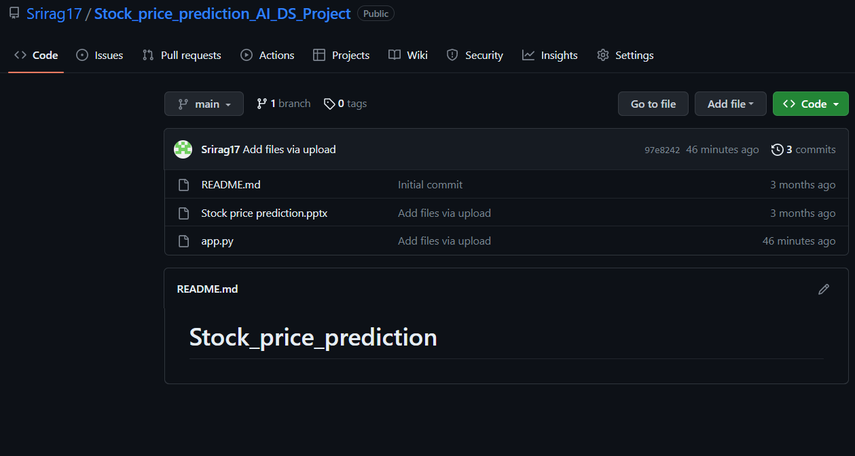
GITHUB SETUP

Slide 8
Thank You!

